Slide 1
[Some of the slides have been adapted from Himanshu Gupta’s presentation at workshop on Big Data analytics August 20-21, 2015]
Hadoop Eco-System

Slide 2




Introduction to Hive

Slide 3
Motivation
At the time Hive was created, Facebook had a bout 15TB of dataset to handle. But within a short years later, that data had grown to 700TB.
They created Hive, their vision was to bring fimiliar database concepts to Hadoop.
In 2008 Hive was open-sourced. Facebook has since used Hive for reporting dashboards and ad-hoc analysis.
3

Slide 4
Motivation
Limitation of MR
Have to use M/R model
Not Reusable
Error prone
For complex jobs:
Multiple stage of Map/Reduce functions
Just like ask dev to write specify physical execution plan in the database
Introduction to Hive

Slide 5
Overview
What's Hive
A data warehousing system to store structured data on Hadoop file system
Provide an easy query these data by execution Hadoop MapReduce
plans
Hive facilitates easy data summarization, ad-hoc queries, and the analysis of very large datasets that are stored in Hadoop.
Hive provides SQL interface, better known as HiveQL or HQL for short, which allows for easy querying for data in Hadoop.
HiveQL has its own Data Definition and Data Manipulation languages which are very similar to DDL and DML.
2/5/2015 Introduction to Hive

Slide 6
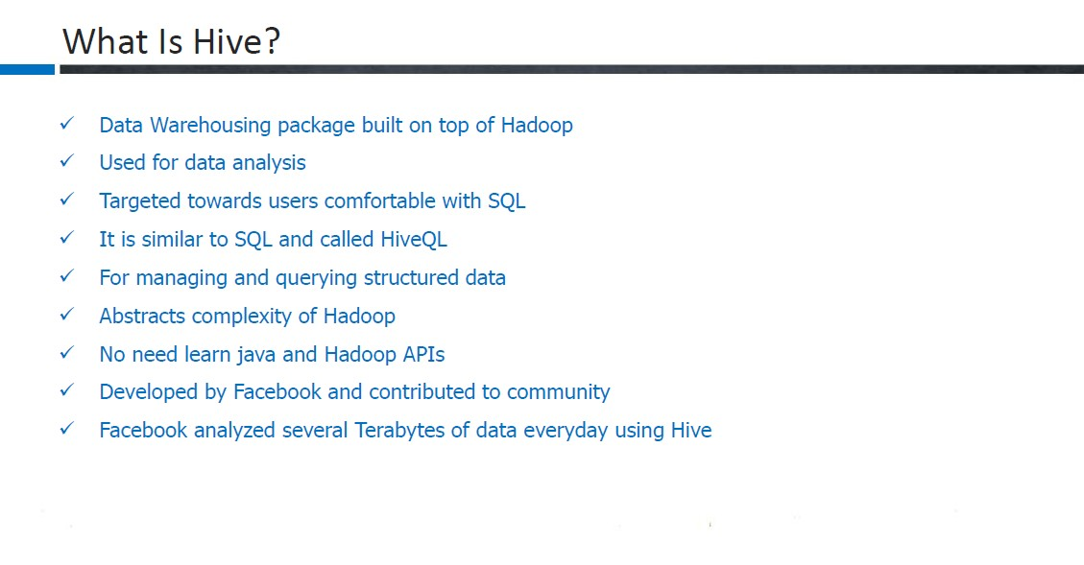

Slide 7
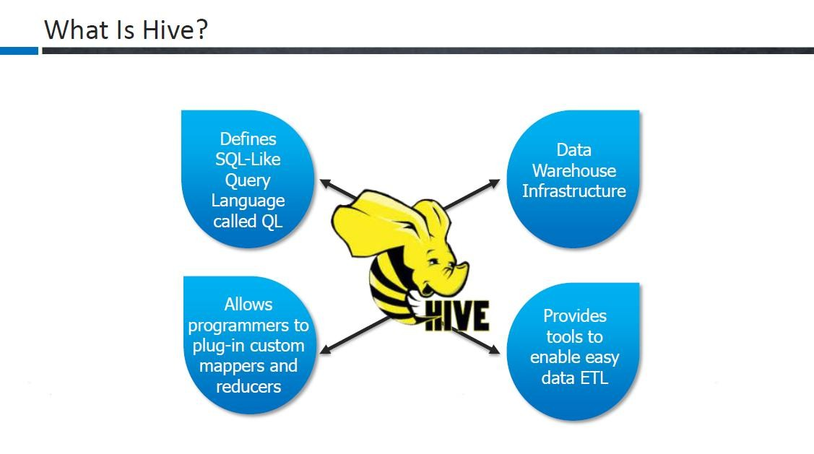

Slide 8
Hive
HiveQL is SQL-like language to query data stored on HDFS
Example – “Select c.ID, c.Name, c.AGE, o.Amount From Customers c JOIN Orders o on (c.ID = o.CUSTOMER)
Data Model
Tables – Column types (int, float, string, data, Boolean)
Supports array / map / struct for Json like data
Meta-Store
Name-space containing set of tables, list of columns and their types and SerDe info
CLI- Command Line Interface
Other languages – Pig

Slide 9
Data Model
Tables
Basic type columns (int, float, boolean)
Complex type: List / Map ( associate array)
Partitions
Buckets
CREATE TABLE sales( id INT, items ARRAY<STRUCT<id:INT,name:STRING>
) PARITIONED BY (ds STRING)
CLUSTERED BY (id) INTO 32 BUCKETS;
SELECT id FROM sales TABLESAMPLE (BUCKET 1 OUT OF 32)
Introduction to Hive

Slide 10
Metadata
Database namespace
Table definitions
schema info, physical location In HDFS
Partition data
Object Relational Mapping Framework
All the metadata can be stored in Derby by default
Any database with JDBC can be configured
>> Technique for converting data between incompatible type systems.
Introduction to Hive

Slide 11
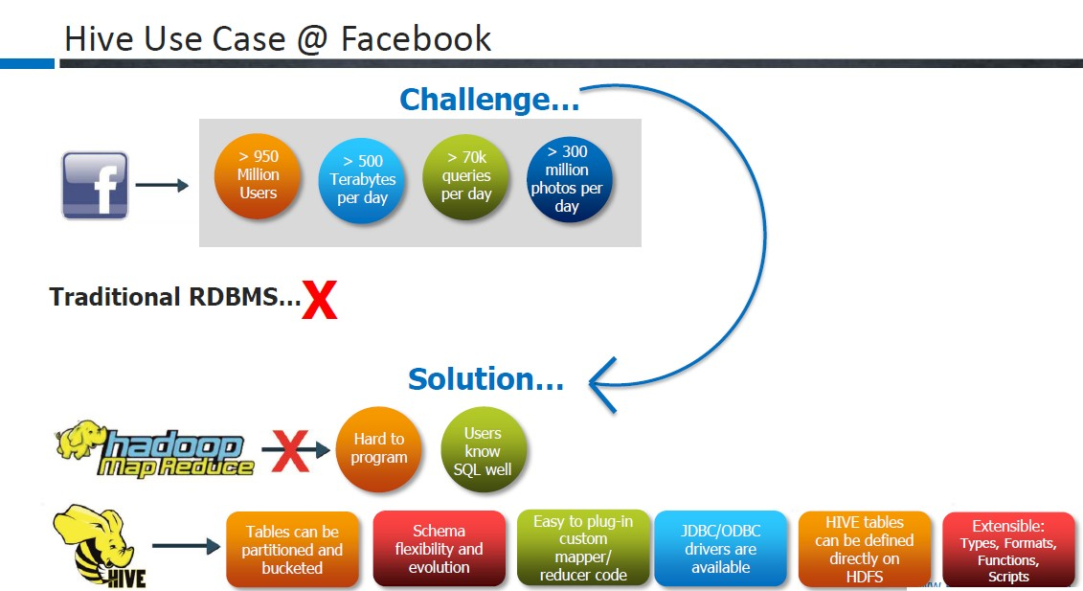

Slide 12
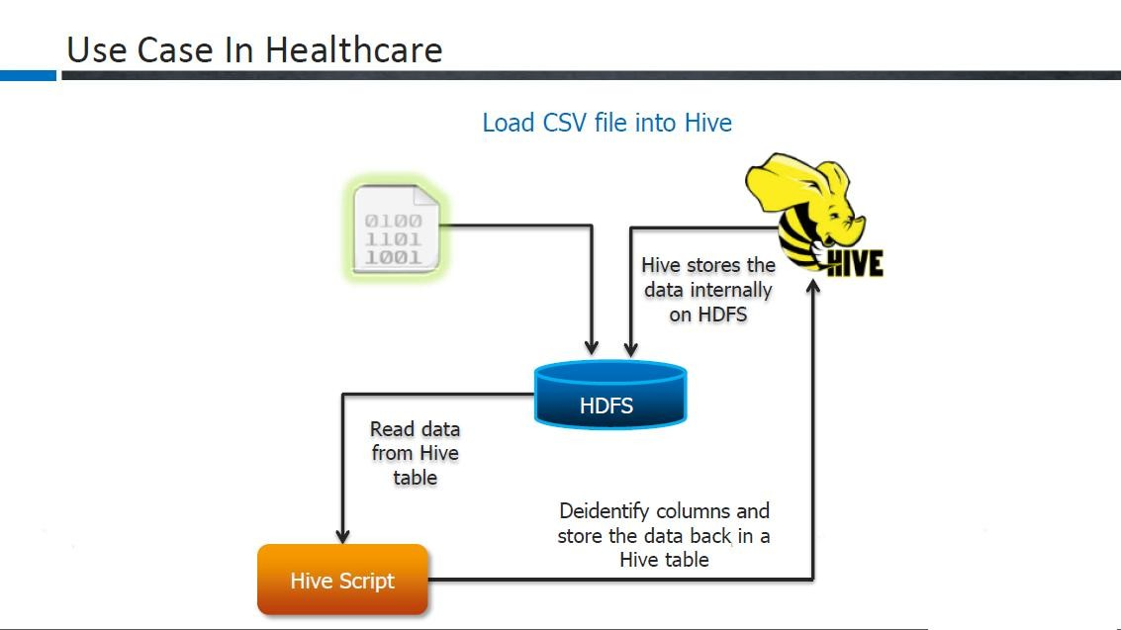
Hive Work Flow Diagram

Slide 13
Hive Components
Shell Interface: Like the MySQL shell
Driver:
Session handles, fetch, exeucition
Complier:
Prarse,plan,optimzie
Execution Engine:
DAG stage
Run map or reduce
Introduction to Hive

Slide 14
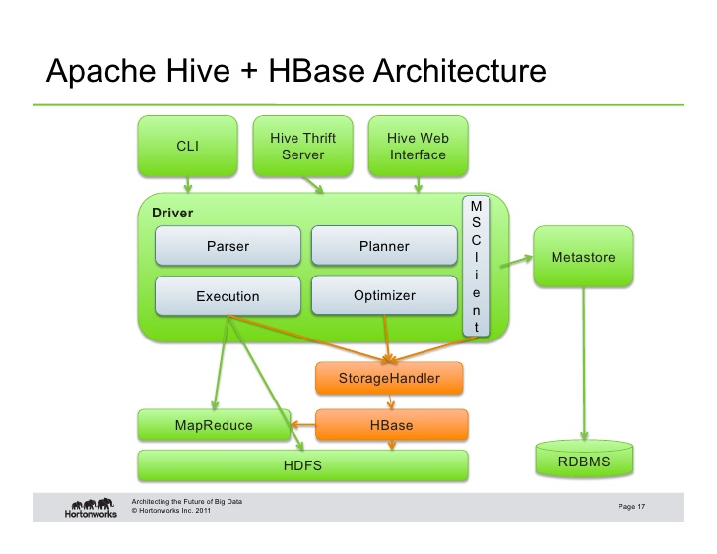
Thrift Hive Server
HiveServer is an optional service that allows a remote client to submit requests to Hive,
using a variety of programming languages, and retrieve results

Slide 15
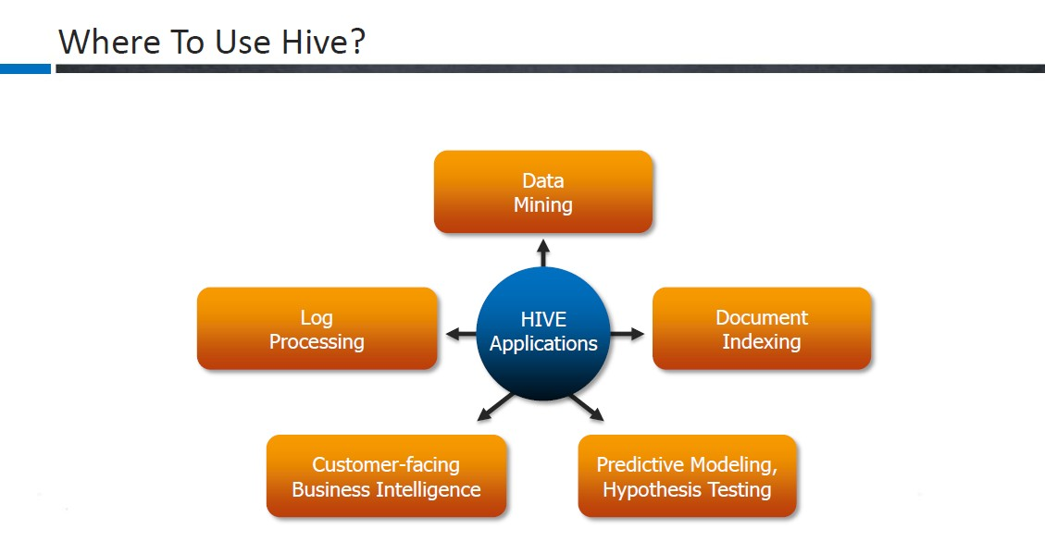

Slide 16
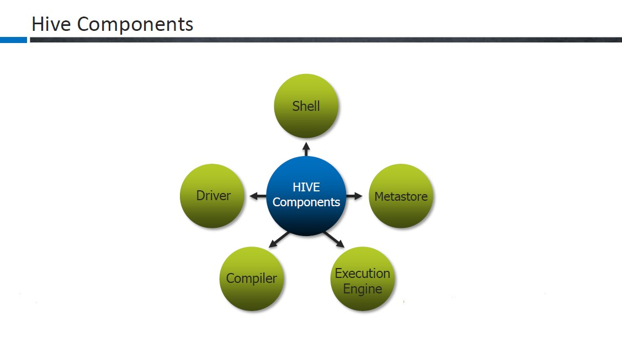

Slide 17
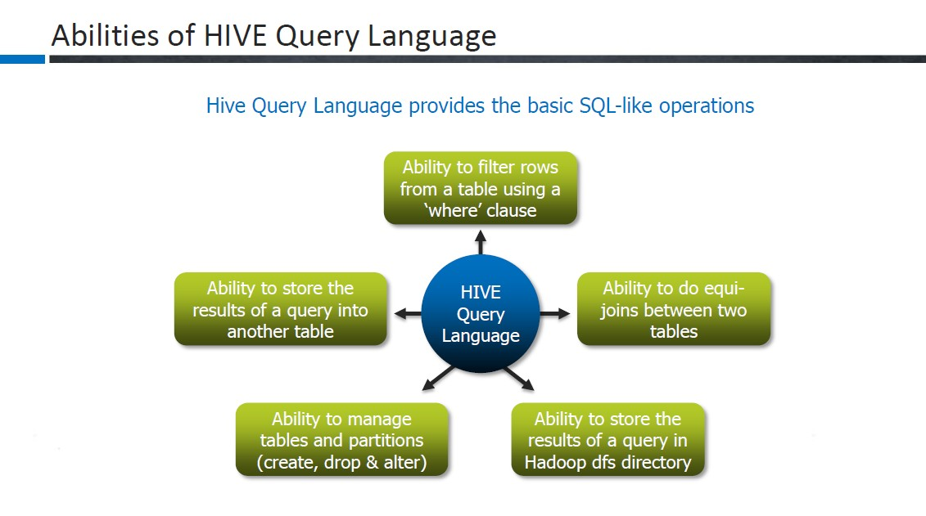

Slide 18
Pros
Pros
A easy way to process large scale data
Support SQL-based queries
Provide more user defined interfaces to extend
Programmability
Efficient execution plans for performance
Interoperability with other database tools
Introduction to Hive

Slide 19
Cons
Cons
No easy way to append data
Files in HDFS are immutable
Future work
Views / Variables
More operator
✶ In/Exists semantic

Slide 20
Hive Usage
hive> show tables;
hive> create table SHAKESPEARE (freq INT, word STRING) row format delimited fields terminated by “\t" stored as textfile
Introduction to Hive

Slide 21
Hive Usage
hive> load data inpath “shakespeare_freq” into table shakespeare;
hive> select * from shakespeare where freq>100 sort by freq asc limit 10;
Introduction to Hive

Slide 22


HBASE

Slide 23
HBase
Hadoop performs only Batch processing. Data will be accessed only in a sequential manner.
One has to search the entire dataset for the simplest of jobs.
HBase provides random read/write access to data in HDFS
Data Model –
A table is a collection of rows
A row is a collection of column families
A column family is a collection of columns
A column is a collection of key-value pairs

Slide 24
NO SQL
NoSQL - Not only SQL
HBase is not intended to replace your traditional RDBMS
HBase is designed for specific business needs

Slide 25
NOSQl example
Id | name | salary
101 | a | 100
102 | b | 200
IN NOSQL FORMAT:-
101 cloumn = cf:name ts value = ‘a’
101 cloumn = cf:salary ts value =100’
102 cloumn = cf:name ts value = ‘b’
102 cloumn = cf:salary ts value =200

Slide 26
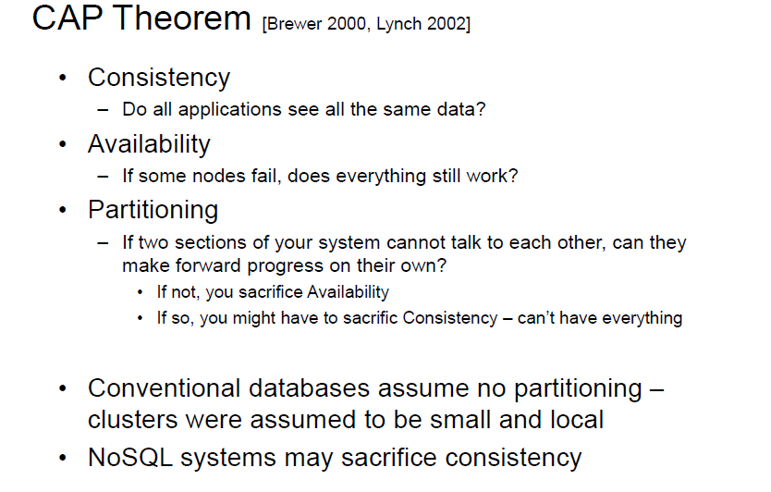

Slide 27
HBase
Reading – Get and Scan. Reader will always read the last written values
Rows are ordered.
Hbase is not
an SQL database, relational, joins, secondary-indices,
Horizontally Scalable

Slide 28
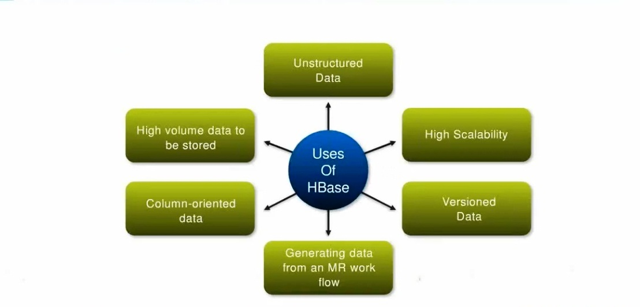
USES of HBASE

Slide 29
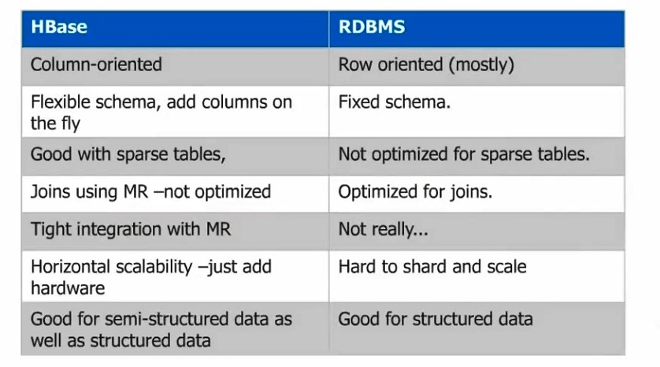
HBASE VS RDBMS

Slide 30
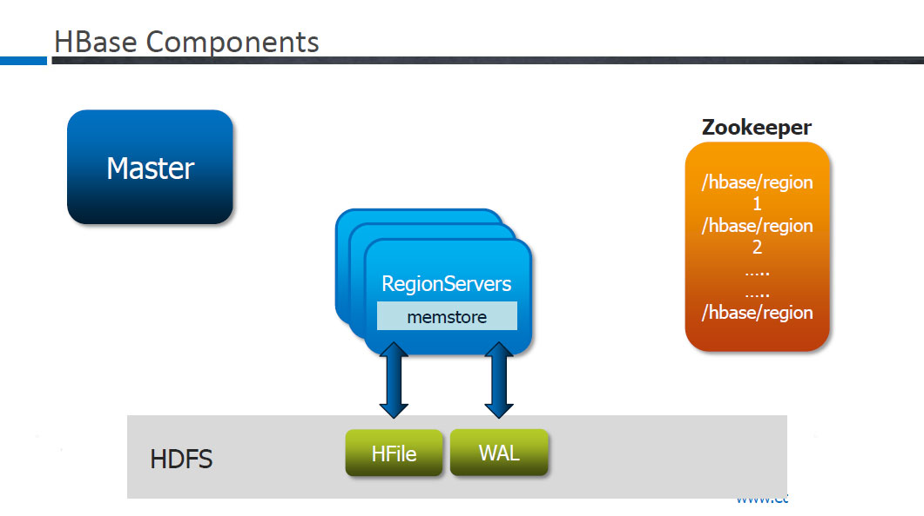

Slide 31
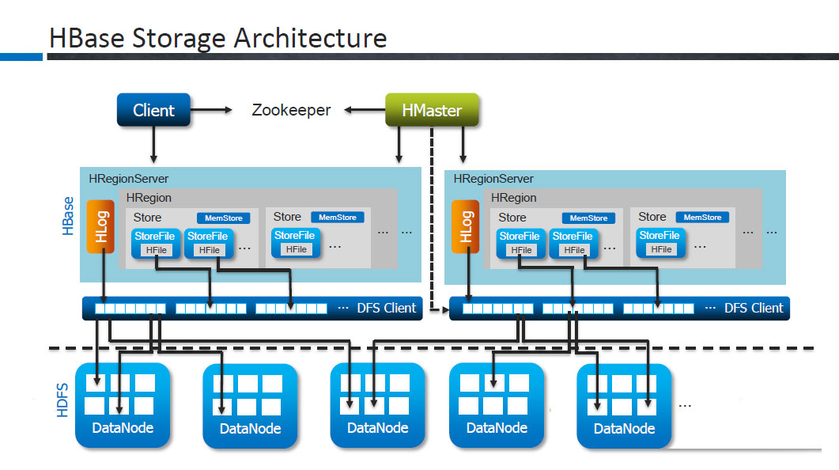

Slide 32
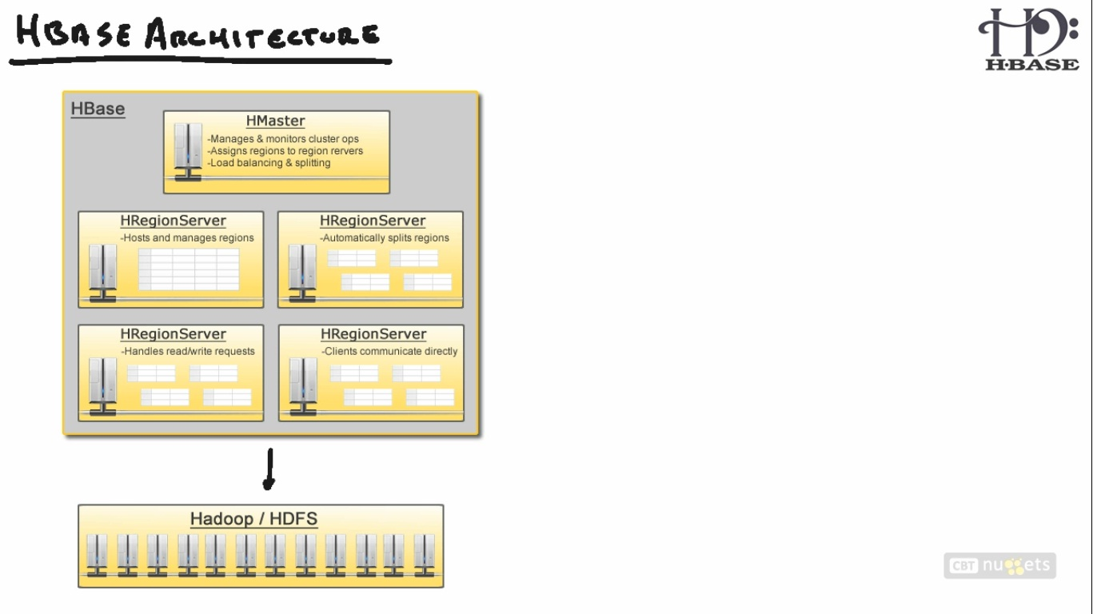
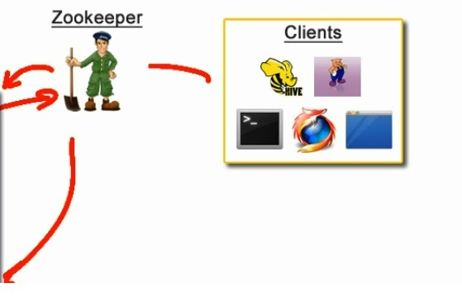

HBASE ARCHITECTURE

Slide 33
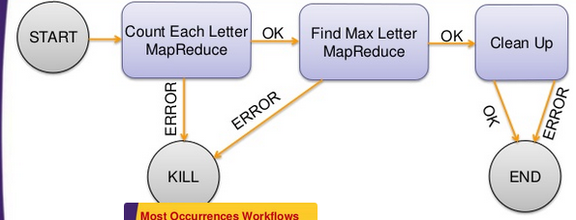
Oozie
Workflow management and coordination of these workflows
Workflow consist of Action nodes (MR, Pig, Hive) and Control Nodes. Specified through an xml file

Slide 34
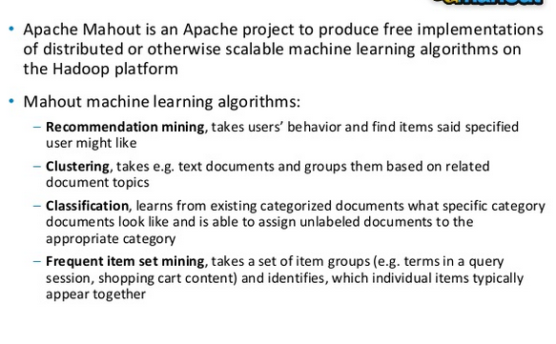
Apache Mahaout

Slide 35
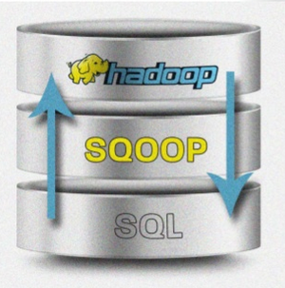
Sqoop
Apache Sqoop is designed for efficiently transferring bulk data between Apache Hadoop and RDBMS
Imports data from external structured datastores into HDFS or related systems like Hbase

Slide 36
Apache Flume
A service for streaming logs into Hadoop
Flume and other services that deliver raw data into an Enterprise Hadoop cluster.
Apache Flume is a distributed, reliable, and available service for efficiently collecting, aggregating, and moving large
amounts of streaming data into t he Hadoop Distributed File System (HDFS). It has a simple and flexible architecture
based on streaming data f lows; and is robust and fault tolerant with tunable reliability mechanisms for failover and recovery.

Slide 37
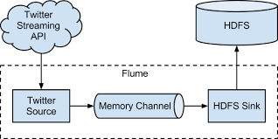
Apache Flume (contd.)

Slide 38
PIG

Slide 39
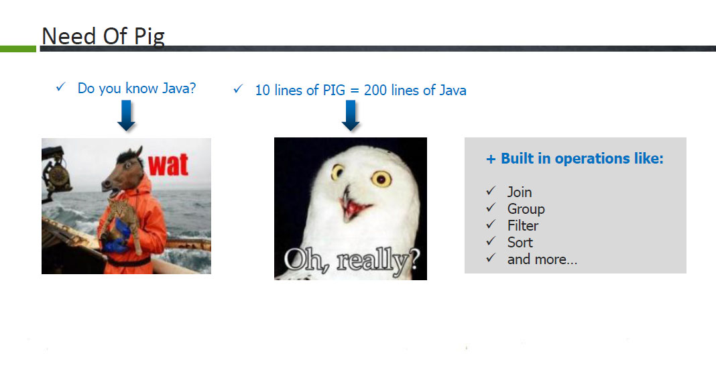

Slide 40
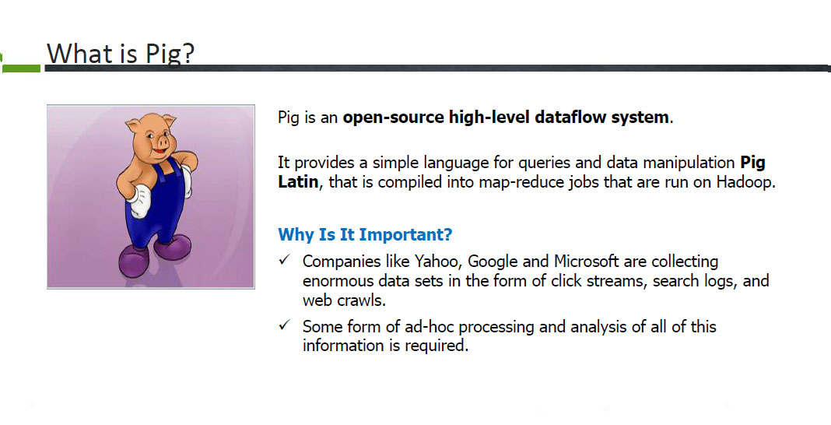

Slide 41
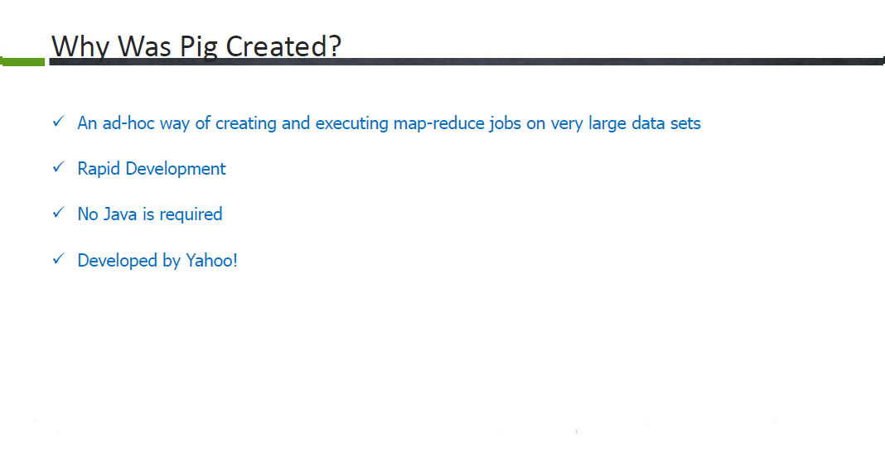

Slide 42
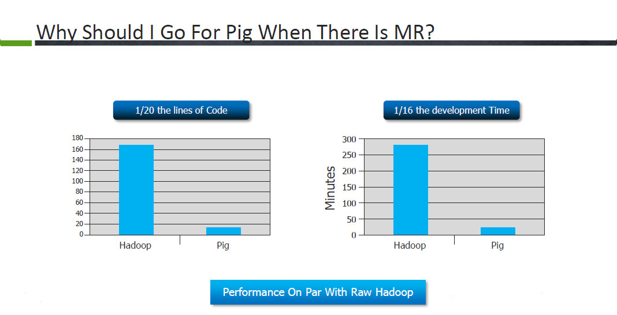

Slide 43
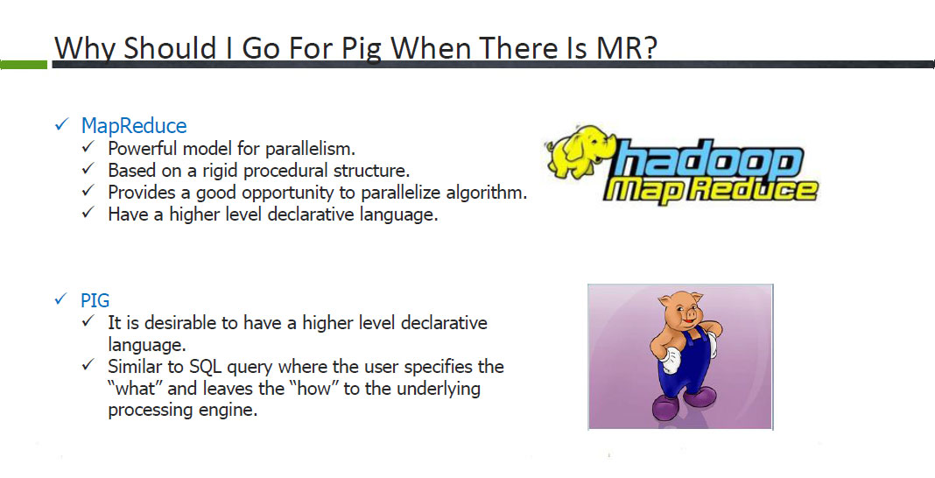

Slide 44
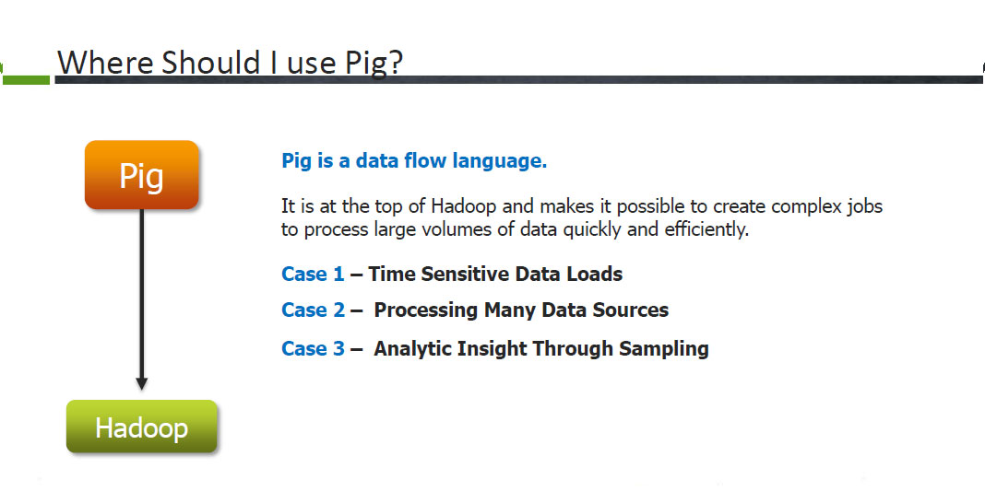

Slide 45
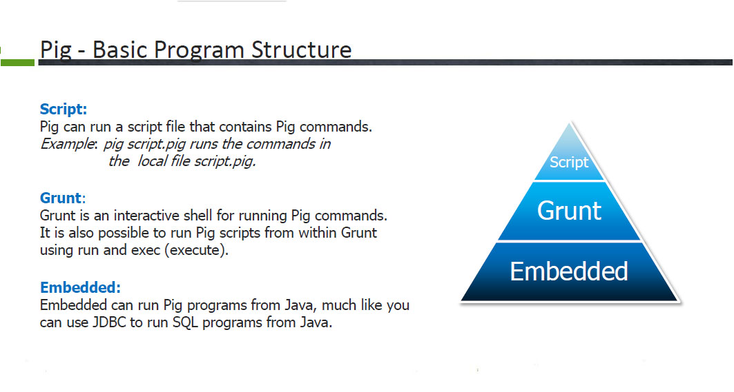

Slide 46
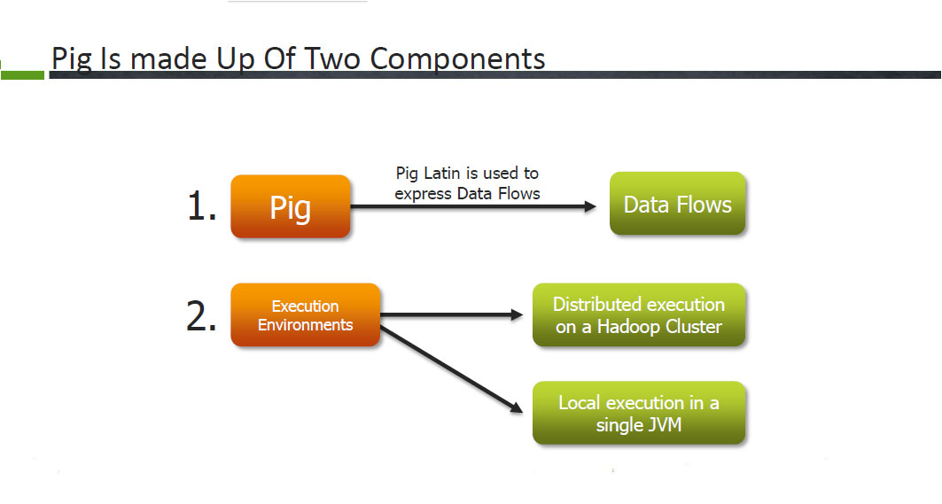

Slide 47
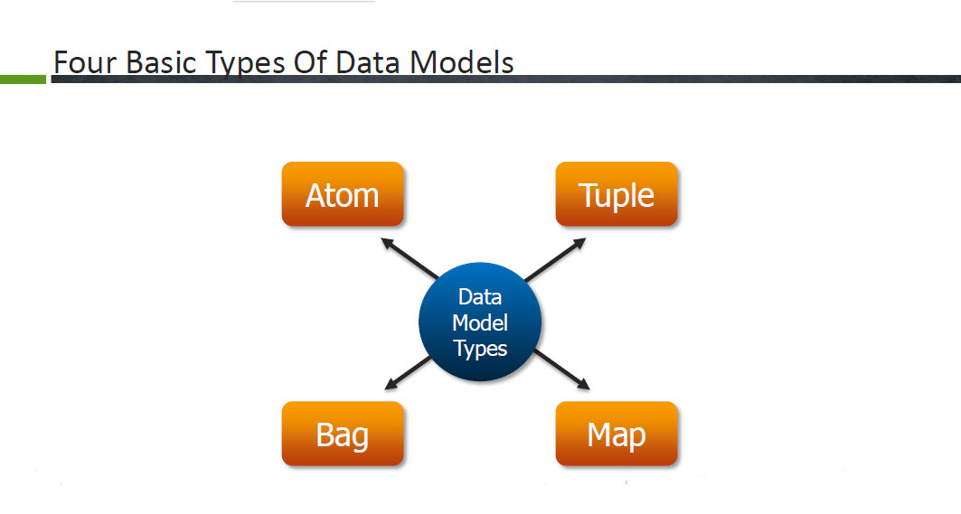

Slide 48
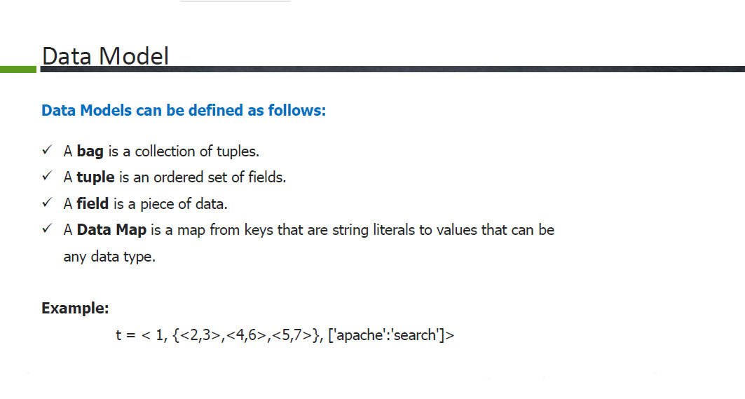

Slide 49
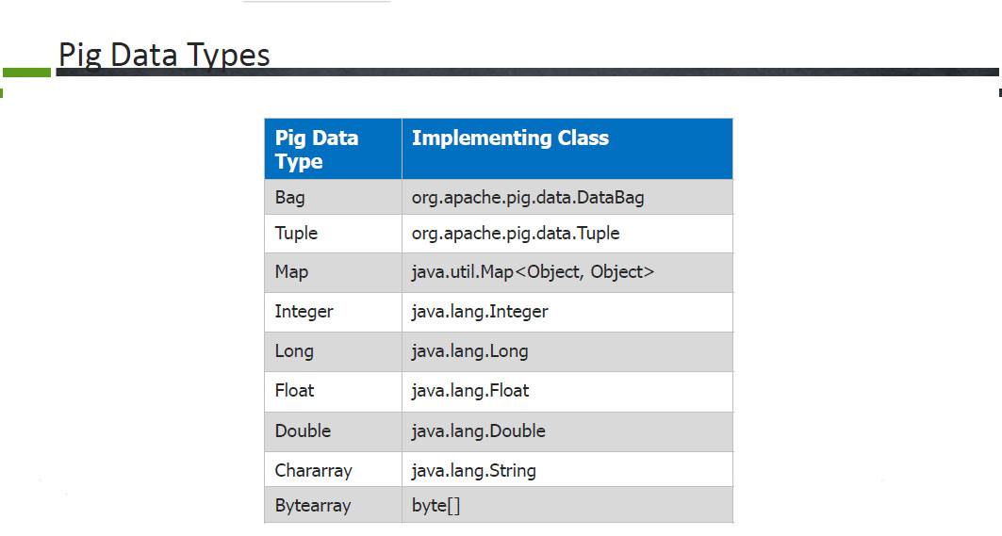

Slide 50
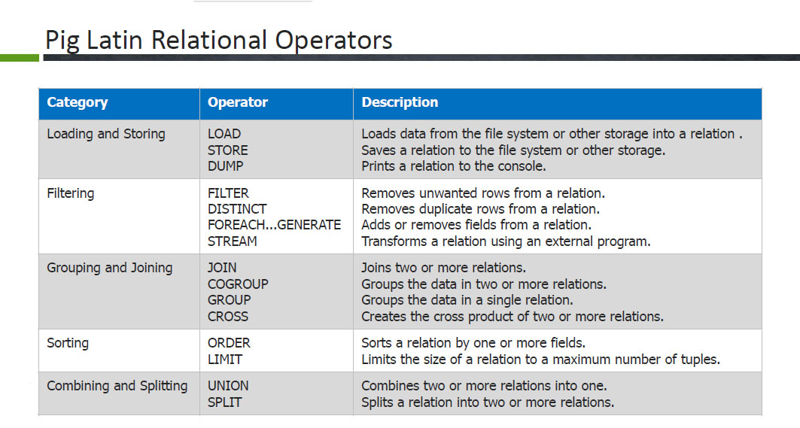

Slide 51
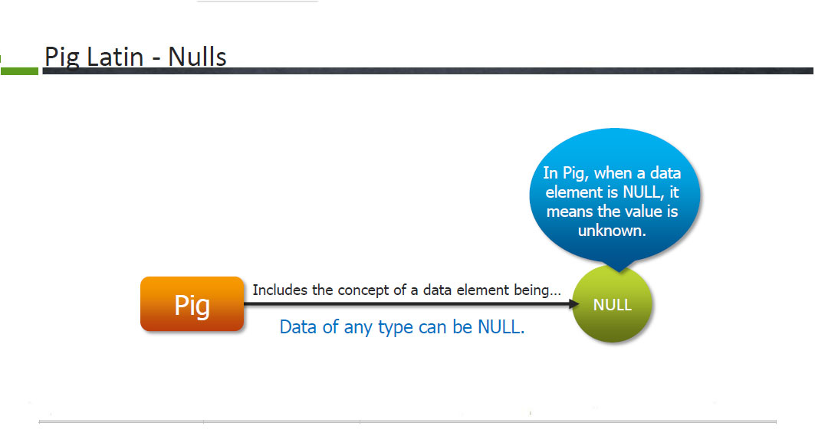

Slide 52
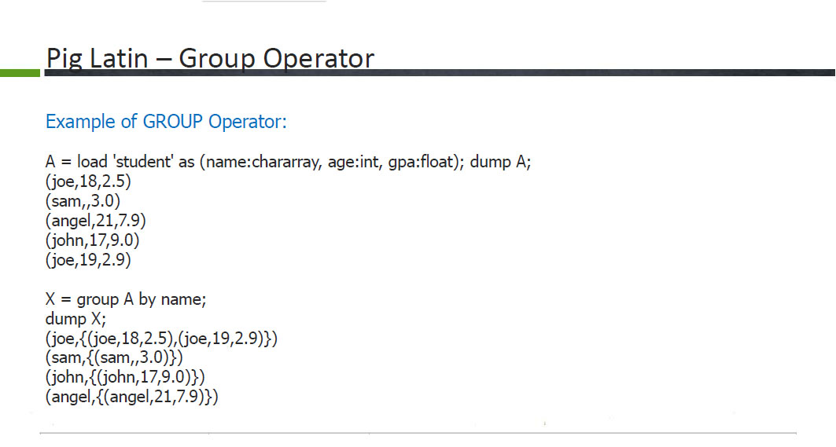

Slide 53
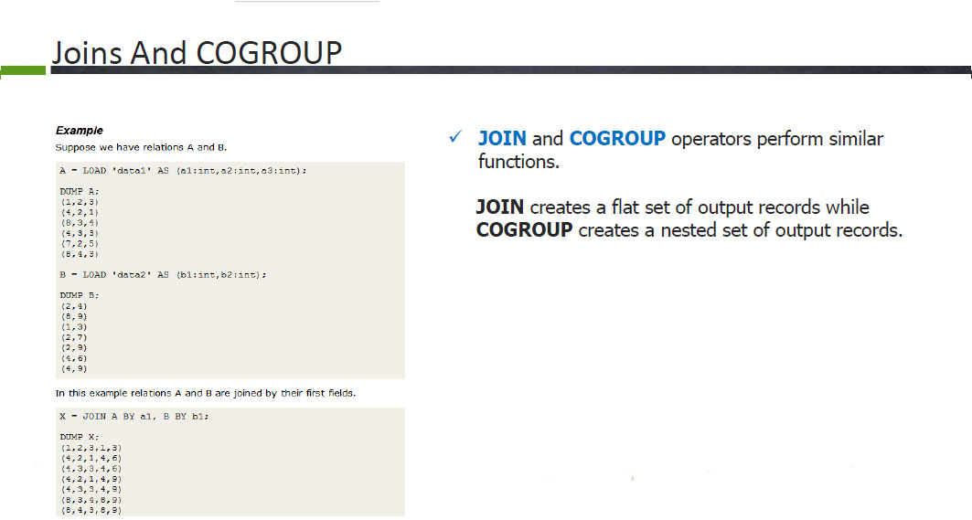

Slide 54
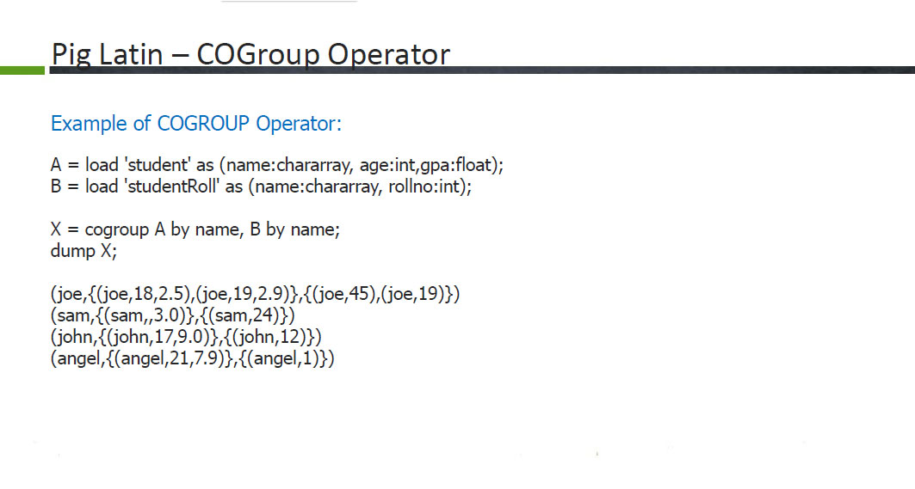

Slide 55
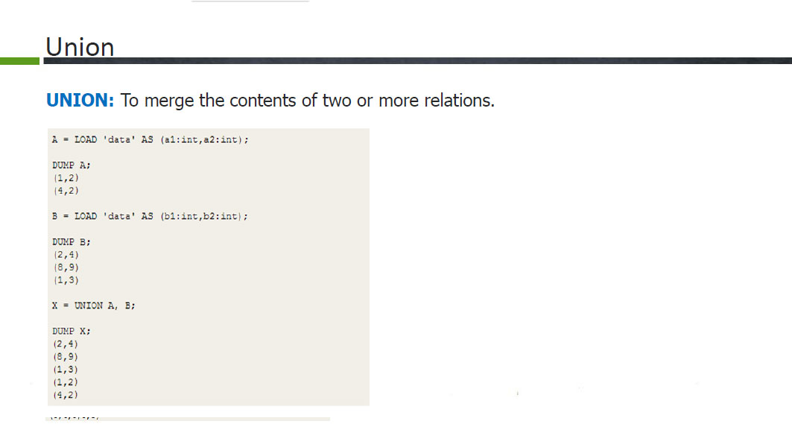

Slide 56
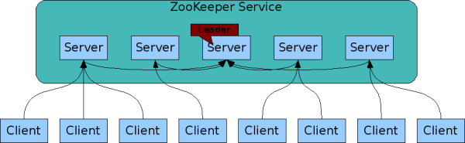
Zookeeper
ZooKeeper is a centralized service for maintaining configuration information, naming, providing distributed synchronization, and providing group services. All of these kinds of services are used in some form or another by distributed applications. Each time they are implemented there is a lot of work that goes into fixing the bugs and race conditions that are inevitable.

